Slide 1
AVERAGE EFFECT
Mean centred familiarity covariate

Slide 2
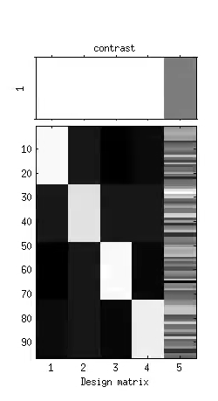
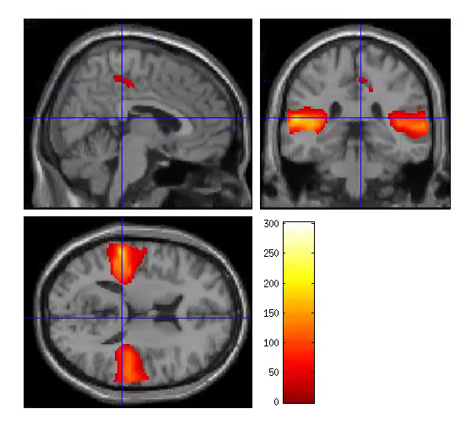
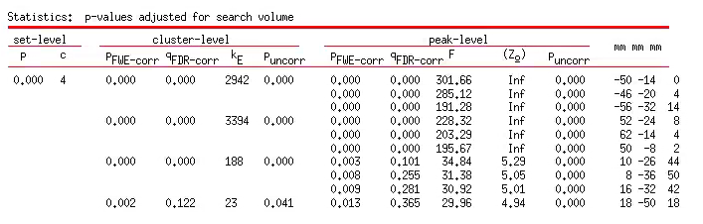
Familiarity covariate – S1TBL
P<0.05 FWE cor
Extent threshold = 18 voxels
modelS1TBL_mean
Con_001

Slide 3
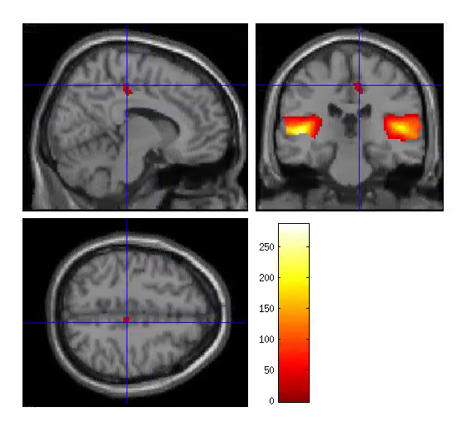
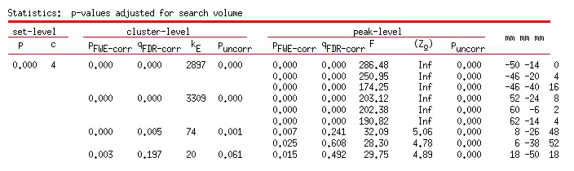
Familiarity covariate – S1TBL - 22 SUBJECTS
P<0.05 FWE cor
Extent threshold = 19 voxels
modelS1TBL_22subj_mean
Con_001
ROI1
ROI2
ROI3

Slide 4
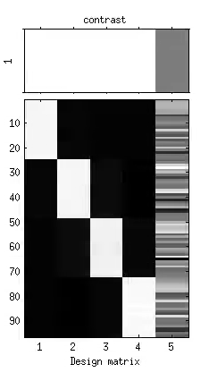
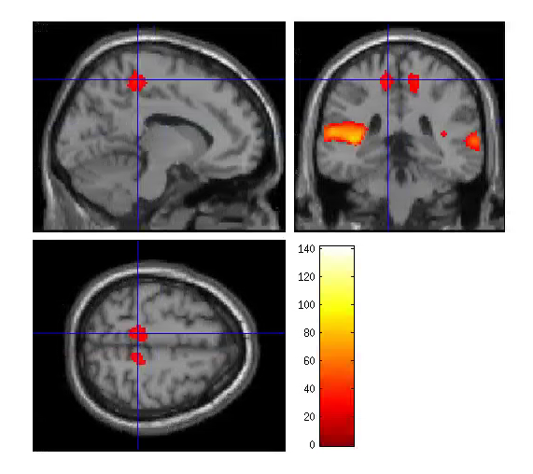
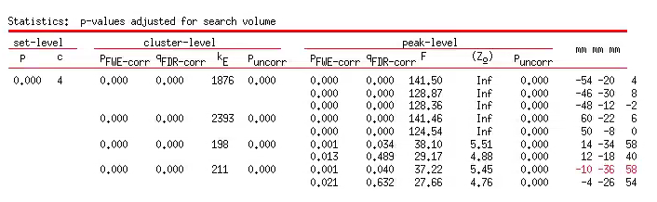
Familiarity covariate – S2TBL
P<0.05 FWE cor
Extent threshold = 24 voxels
modelS2TBL_mean

Slide 5
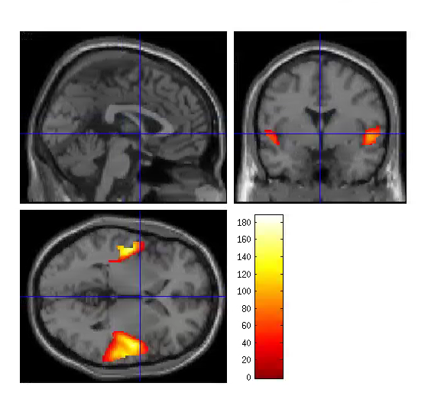
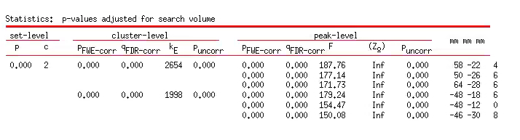
Familiarity covariate – S2TBL – 22 SUBJECTS
Extent threshold = 22 voxels
P<0.05 FWE cor
modelS2TBL_22subj_mean
Significant main effect of familiarity at both ROIS
(R anova)
ROI1
ROI2

Slide 6
EFFECTS OF INTEREST
Mean centred familiarity covariate

Slide 7
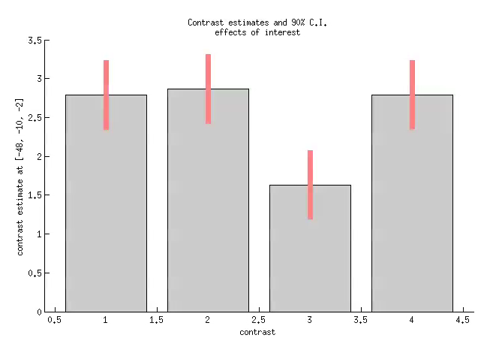
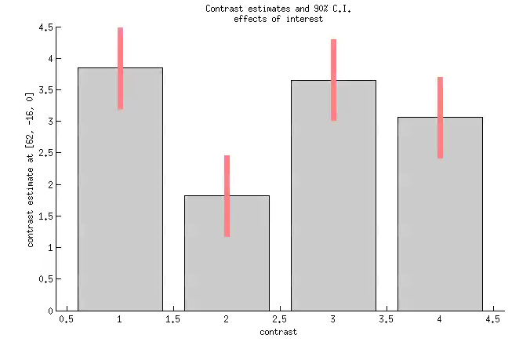
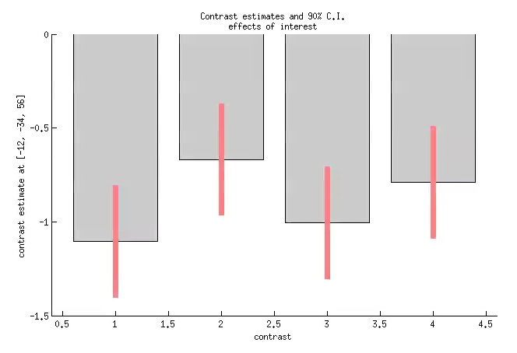
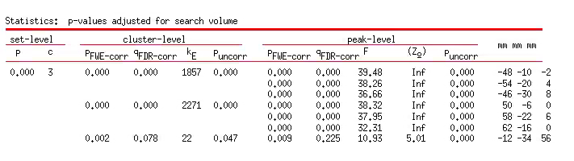
S2TBL – familiarity covariate
Extent threshold 18
P<0.05 FWE cor
-48,-10,-2
-54,-20,4
-46,-30,8
50,-6,0,
58,-22,6
62,-16,0
-12,-34,56

Slide 8
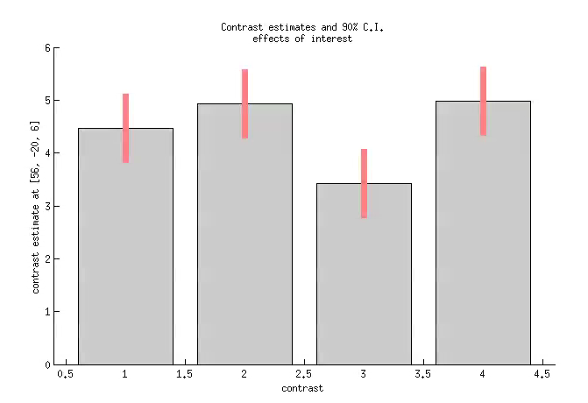
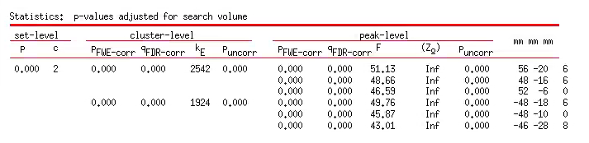
S2TBL – familiarity covariate 22 SUBJECTS
Extent threshold 16
P<0.05 FWE cor
56,-20,6
48,-16,6
52,-6,0
-48,-18,6
-48,-10,0
-46,-28,8

Slide 9
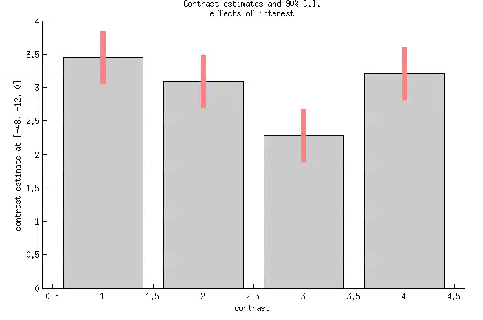
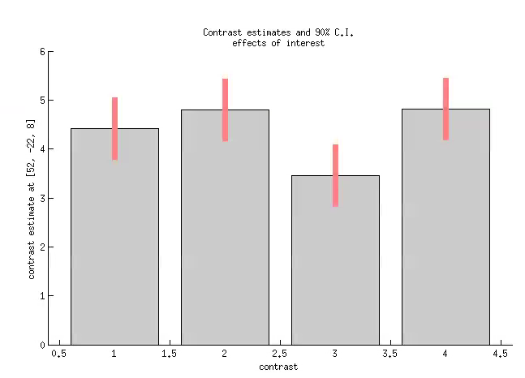
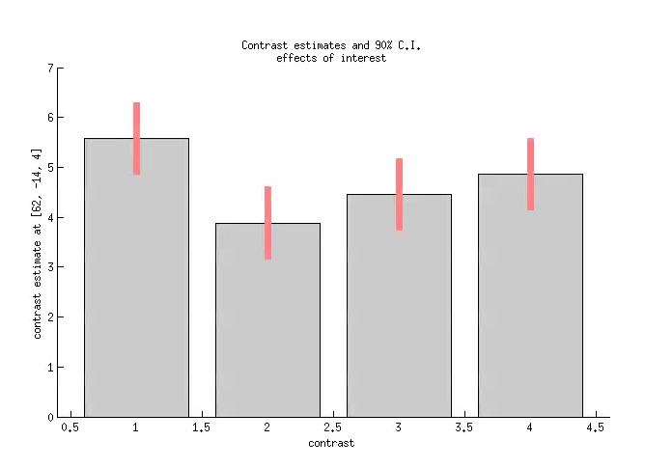
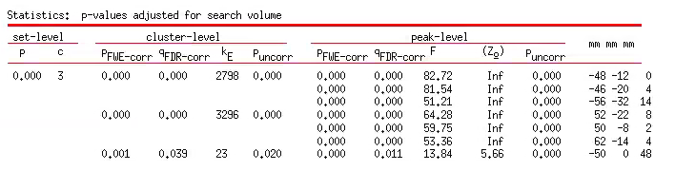
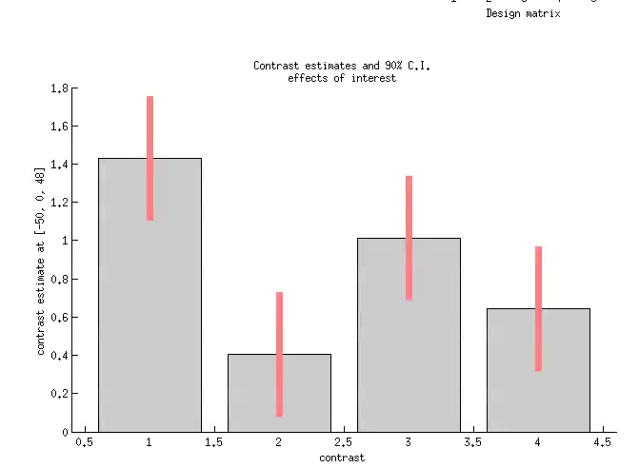
S1TBL – familiarity covariate
Extent threshold 13
P<0.05 FWE cor
-48,-12,0
-46,-20,4
-56,-32,14
52,-22,8
50,-8,2
62,-14,4
-50,0,48

Slide 10
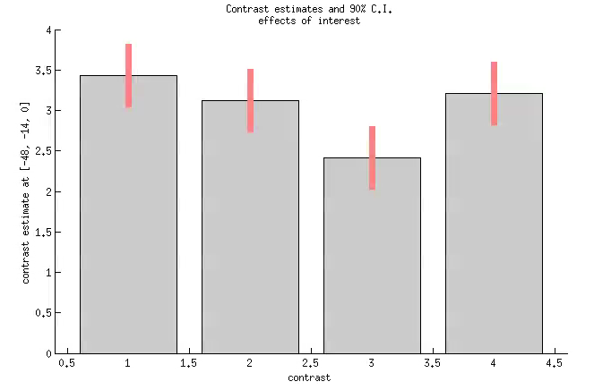
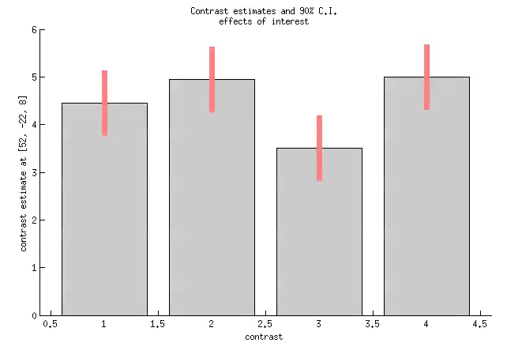
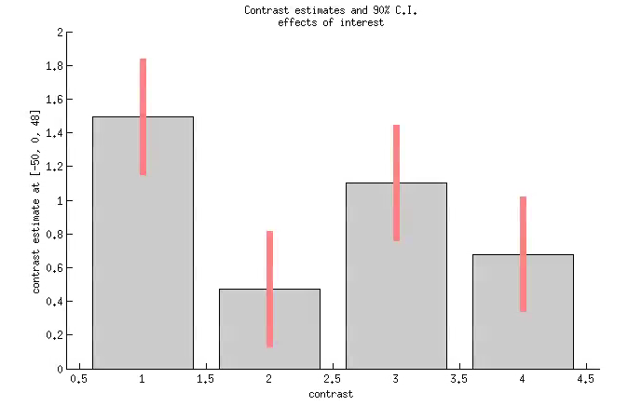
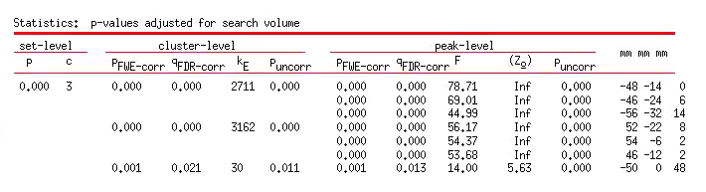
S1TBL – familiarity covariate 22 SUBJECTS
Extent threshold 14
P<0.05 FWE cor
-48,-14,0
-46,-24,6
-56,-32,14
52,-22,8
54,-6,2
46,-12,2
-50,0,48

